Slide 1
KeyStone II ARM Cortex A-15 CorePac Overview
MCP-MGM Applications Team
December 2012

Slide 2
Agenda
ARM CorePac in KeyStone II
ARM Cortex A-15 Features
Interface to the SOC and Coherency Issues
Benchmarks
Interrupt Controller
Power Management
Debug and Trace

Slide 3
ARM CorePac in KeyStone II
ARM CorePac in KeyStone II
ARM Cortex A-15 Features
Interface to the SOC and Coherency Issues
Benchmarks
Interrupt Controller
Power Management
Debug and Trace

Slide 4
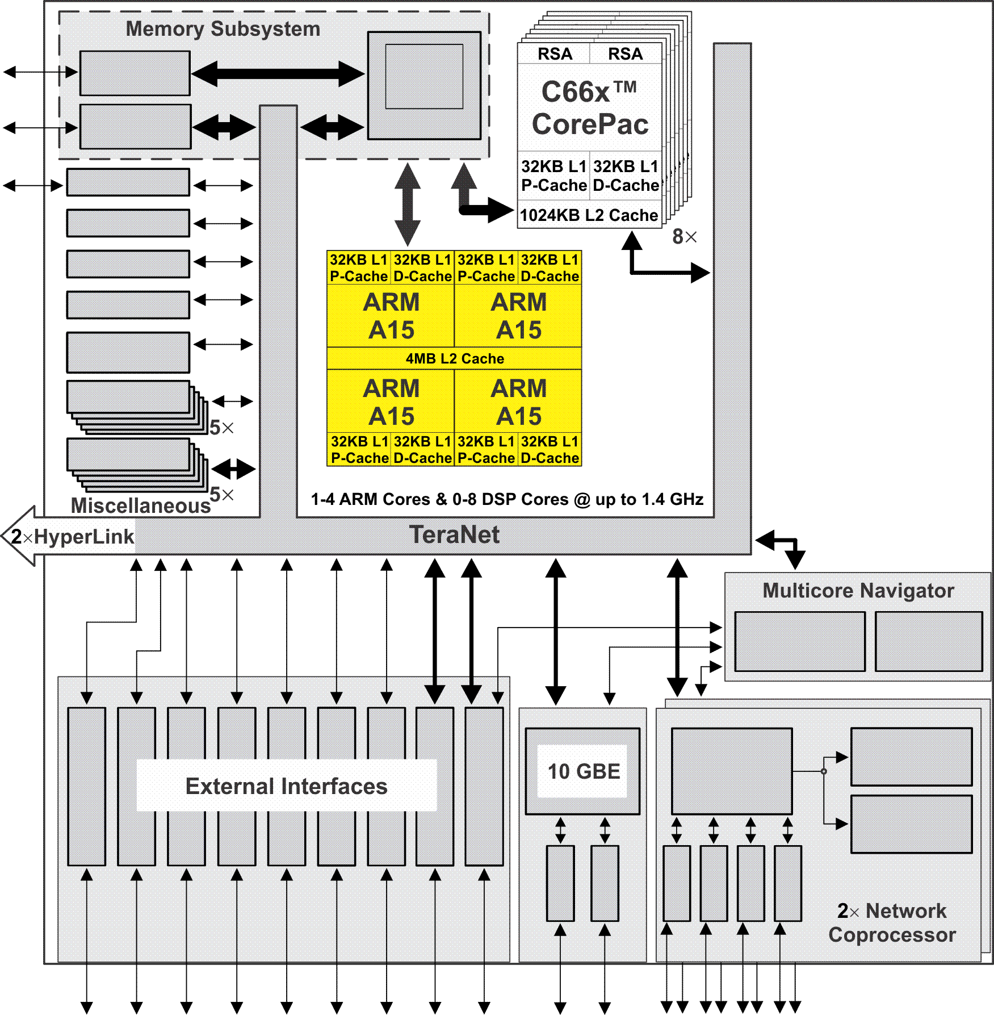
KeyStone II and ARM CorePac
Single, Dual, or Quad-ARM Cortex A15 CorePac operating at up to 1.4 GHz.
L1 Memory: 32KB L1 Data cache 32KB L1 Program Cache
Up to 128-bit access
64 bytes L1 D cache line (up to 6 outstanding requests)
L2 Memory: 4 MB L2 Cache is shared between the 1 to 4 ARM A-15 core(s) (4 tag bank, 4 data bank each)
64 bytes cache line
Notes:
4
Contains an ARM cluster with one, two or 4 ARMs in it.
Running at 1.4GHz.
Two levels of memory just like DSP.
But L2 is shared for cache coherency.
Connected to the MSMC through ACE also provided cache coherency with other peripheral masters.
Power management.(Wait for Interrupt/ Wait for Event).
BootROM.

Slide 5
KeyStone II and ARM CorePac (2)
AMBA 4.0 AXI Coherency Extension (ACE) master port
Module interrupt controller
Cluster-level and core-level power management and low-power standby modes
Configured 64/128 bit AMBA interface and 64/128 bits accelerator coherency support (ACP)
Advance debug features
Notes:
5
Contains an ARM cluster with one, two or 4 ARMs in it.
Running at 1.4GHz.
Two levels of memory just like DSP.
But L2 is shared for cache coherency.
Connected to the MSMC through ACE also provided cache coherency with other peripheral masters.
Power management.(Wait for Interrupt/ Wait for Event).
BootROM.

Slide 6
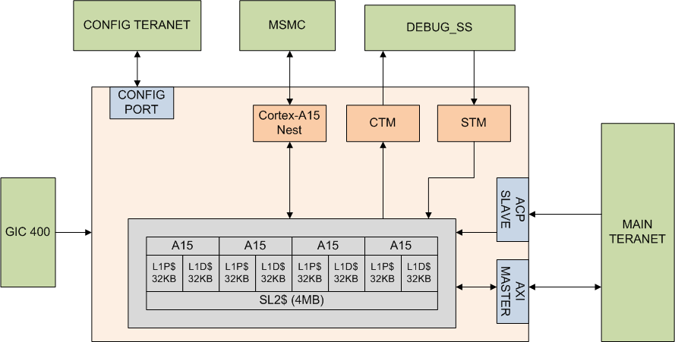
ARM CorePac Functional Block Diagram
Notes:
CTM – Cross Trigger matrix
STM – System Trace Microcell
ACP – Accelerated coherency port
Next – Asynchronous interface to MSMC
AXI – is really via the MSMC
This is a functional diagram. Physically, all ports go through the MSMC port (except the interrupt?)

Slide 7
ARM Cortex A-15 Features: ARM Core
ARM CorePac in KeyStone II
ARM Cortex A-15 Features
ARM Core
NEON
VFP
MMU
Interface to the SOC and Coherency Issues
Benchmarks
Interrupt Controller
Power Management
Debug and Trace

Slide 8
Cortex A-15 Features – The Core (1/2)
Superscalar architecture
2 ALU, 2 shifts, branch unit, multiply and divide, load store
3 concurrent dispatched, up to 8 concurrent issues
Full implementation of ARMv7-A architecture instruction set
More MAC instructions (normalization and rounding)
Integer divide
Automatic thumb mode (16-bit instructions)
Pipeline optimization
Deeper pipeline 13 stages to issue (2 integer, 4 multiply and load, more for NEON and FPU(2-10))
Out-of-order pipeline (3-12 stages) execution
Notes:
8 issues:
2 for Neon- VFP
2 for load and store
4 for the other (ALU, Shift, multiply)

Slide 9
Cortex A-15 Features – The Core (2/2)
Dynamic branch prediction – Loop prediction and indirect branch predictor
Branch Target Buffer (BTB)
Global History Buffer (GHB) has three arrays:
Taken array
Not taken array
Selector array
Sophisticated hardware algorithm makes the prediction

Slide 10
Cortex A-15 Features – Fetch & Memory
Increase fetch from 64 to 128 bits
Full support for unaligned fetch address
L1D and L1P
32KB size
Configured as cache
L2 is unified memory that serves ALL cores in the cluster:
4MB size
Configured as cache

Slide 11
ARM Cortex A-15 Features: NEON
ARM CorePac in KeyStone II
ARM Cortex A-15 Features
ARM Core
NEON
VFP
MMU
Interface to the SOC and Coherency Issues
Benchmarks
Interrupt Controller
Power Management
Debug and Trace

Slide 12
SIMD Engine NEON
64/128-bit data instructions
Fully integrated into the main pipeline
32x 64-bit registers that can be arranged as 128-bit registers
Data can be interpreted as follows:
Byte
Half-word (16-bit)
Word
Long

Slide 13
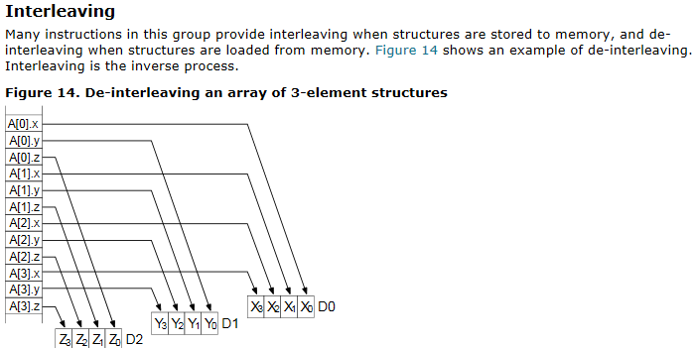
NEON Registers
Load and store data into 64-bits registers from memory with on the fly interleave – from ARM documentation:

Slide 14
ARM Cortex A-15 Features: VFP
ARM CorePac in KeyStone II
ARM Cortex A-15 Features
ARM Core
NEON
VFP
MMU
Interface to the SOC and Coherency Issues
Benchmarks
Interrupt Controller
Power Management
Debug and Trace

Slide 15
Vector Floating Point (VFP)
Fully integrated into the main pipeline
32 DP registers for FP operations
Native (Hardware) support for all IEEE-defined floating-point operations and rounding modes; single and double precision
Supports fused MAC operation (e.g., rounding after the addition or after the multiplication)
Supports half-precision (IEEE754-2008) (1 sign, 5 exponent, 10 mantissa)

Slide 16
ARM Cortex A-15 Features: MMU
ARM CorePac in KeyStone II
ARM Cortex A-15 Features
ARM Core
NEON
VFP
MMU
Interface to the SOC and Coherency Issues
Benchmarks
Interrupt Controller
Power Management
Debug and Trace

Slide 17
Memory Management Unit (MMU)
Logical-to-physical memory translation
Users protection
Hardware manages the actual memory
Large physical addressing, 40-bit (1TB)
Three-level data structure for virtual 4kB page
Two levels for virtual 2MB pages (Linux huge pages)
Translation Lookaside Buffers (TLB) caches one page of address translations per entry to speed up translation process (L1 instruction access, L1 data access and L2 TLB)
Notes:
The translation between virtual address to physical address is done via two or three steps
32 L1 Instructions
2 by 32 data L1
4 ways 512-entry L2 TLB (for each processor)

Slide 18
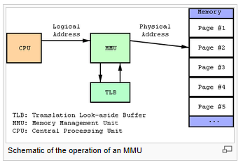
From Wikipedia – MMU, TLB and Page

Slide 19
Memory Management Unit (MMU)
To support multiple operating systems (adding a Guest operating system):
Three privilege layers
User Mode is for “Guest” (application)
Supervisor controls multiple guests
Hypervisor controls the complete system
Two-stage translation
From logical to intermediate physical address for supervisor for each operating system
From intermediate to real address for hypervisor for the complete system

Slide 20
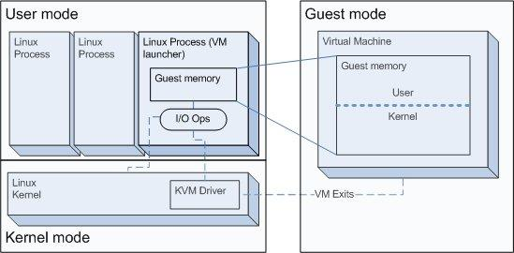
Two Stage MMU – Guest to Supervisor

Slide 21
Two Stage MMU Guest to Supervisor, Supervisor to Hypervisor

Slide 22
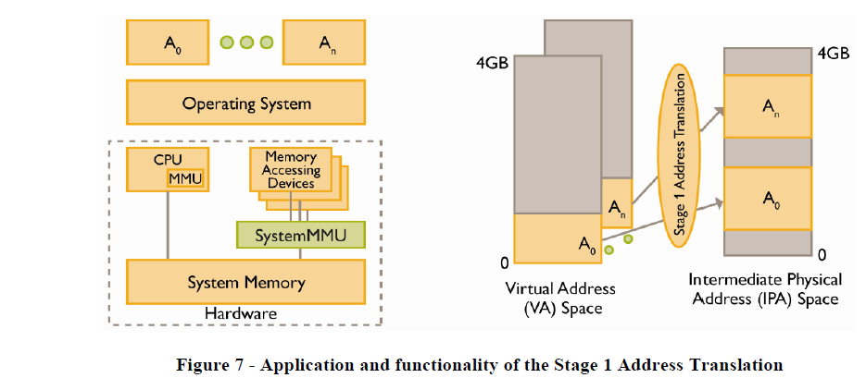
From ARM white paper on two stages MMU

Slide 23
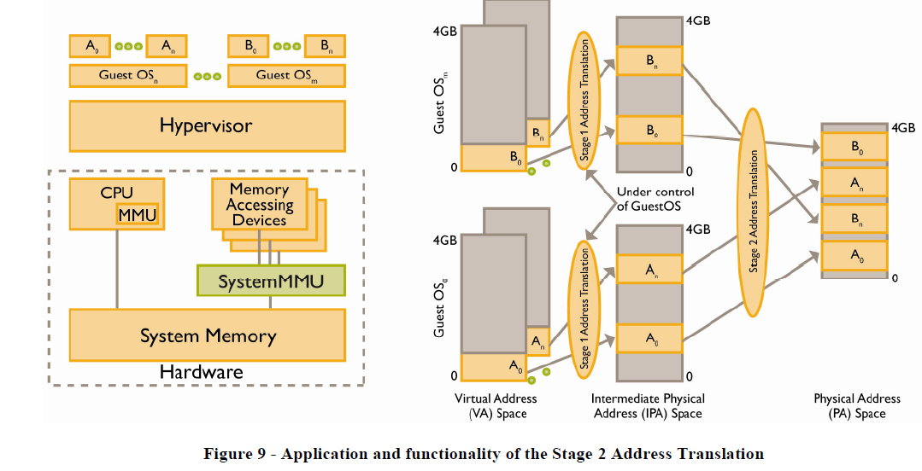
From ARM white paper on two stages MMU

Slide 24
Interface to the SOC and Coherency Issues
ARM CorePac in KeyStone II
ARM Cortex A-15 Features
Interface to the SOC and Coherency Issues
Benchmarks
Interrupt Controller
Power Management
Debug and Trace

Slide 25
ARM Cluster Buses AMBA – Advance Microcontroller Bus Architecture
AXI (AMBA Advanced eXtensible Interface) connects the ARM cluster with MSMC module using the AXI-VBUS master.
APB (AMBA Advanced Peripheral Bus) provides access to peripherals and internal memories.
ATB (AMBA Trace Bus) supports the trace features for the ARM cluster.

Slide 26
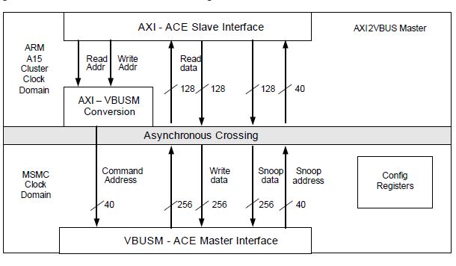
ARM AXI-VBUSM Interfaces to the MSMC

Slide 27
ARM AXI-VBUSM Interfaces to the MSMC
40-bit address access to external memory (8G DDRA, 2G DDRB)
Snooping mechanism maintains coherency between L2 cache and DDRA and MSM memory
Access to all SOC internal memory via TeraNet
ARM cluster PrivID for the TeraNet is 8

Slide 28
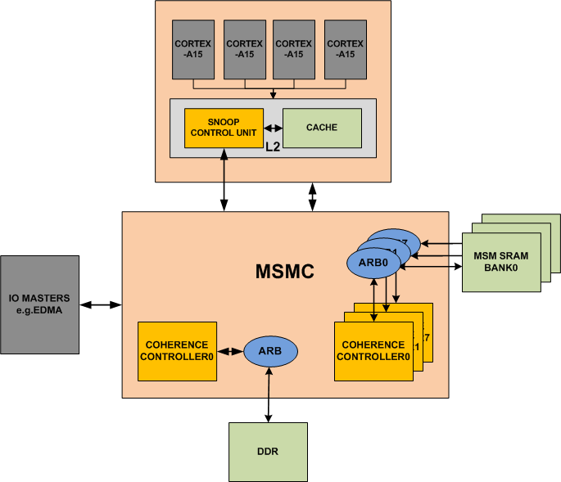
Keystone ll: ARM - IO Coherency External Write to Shared Memory (MSM/DDR)
1
EDMA issues write to shared SRAM

Slide 29
Keystone ll: ARM - IO Coherency External Write to Shared Memory (MSM/DDR)
Coherence Controller issues WBInv snoops to ARM
2
1
EDMA issues write to shared SRAM

Slide 30
Keystone ll: ARM - IO Coherency External Write to Shared Memory (MSM/DDR)
Coherence Controller issues WBInv snoops to ARM
ARM evicts the line
3
2
1
EDMA issues write to shared SRAM

Slide 31
Keystone ll: ARM - IO Coherency External Write to Shared Memory (MSM/DDR)
Coherence Controller issues WBInv snoops to ARM
ARM evicts the victim
3
2
1
4
EDMA issues write to shared SRAM
Coherence controller merges EDMA write with victim & writes to SRAM

Slide 32
Keystone ll: ARM - IO Coherency External Read to Shared Memory (MSM/DDR)

Slide 33
Keystone ll: ARM - IO Coherency External Read to Shared Memory (MSM/DDR)
1
EDMA issues read to shared SRAM

Slide 34
Keystone ll: ARM - IO Coherency External Read to Shared Memory (MSM/DDR)
Coherence Controller issues read snoops to ARM
2
1
EDMA issues read to shared SRAM

Slide 35
Keystone ll: ARM - IO Coherency External Read to Shared Memory (MSM/DDR)
Coherence Controller issues read snoops to ARM
ARM evicts updated data
3
2
1
EDMA issues read to shared SRAM

Slide 36
Keystone ll: ARM - IO Coherency External Read to Shared Memory (MSM/DDR)
Coherence Controller issues read snoops to ARM
ARM evicts updated data
3
2
1
4
Coherence controller returns read data to EDMA
EDMA issues read to shared SRAM

Slide 37
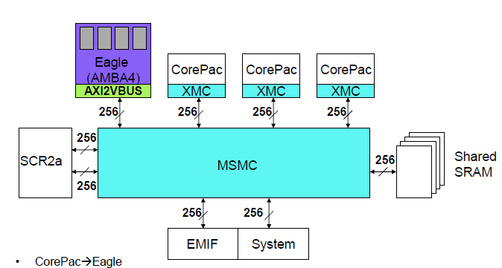
KeyStone II: IO Cache Coherency
ARM
A15
Write-invalidate
Read-snoop for MSMC SRAM
TeraNet
Write-invalidate
Read-snoop for
DDR3A
IO coherency for the ARM, SMP for the quad cluster:
DDR3A from 0x08_0000_0000 to 0x09_FFFF_FFFF (8 G)
MSMC SRAM
Coherency for ease of use and performance
Notes:
One still needs to do ensure consistency, with load and store exclusive instructions and data barriers (DMB); SIMPLIFY?
I think that the reason why there are two snoops is because there are two ways to get into the MSMC and from the MSMC to the memories, but the DSP to MSMC -

Slide 38
ARM CorePac: Cache and Coherency
L1 to L2 cache coherency based on SCU (Snoop Control Unit) algorithm.
Unified L2 Cache coherency for external (to the CorePac) memory and IO; Based on snooping cache coherency protocol.
Between ARM cache and DDR3A
Between ARM cache and MSMC SRAM (on-chip scratch memory)
No IO or DDRB coherency supported by the hardware.
Notes:
Include memory portion of KII diagram

Slide 39
Error Correction and Latency
32KB L1 cache program, 32KB L1 cache data
Large L2 cache (4MB, 16-way set associative)
1MB, 16-way set associative in some variants
Internal and external memory Error Correction Code (ECC)
1 bit error correct, 2 bits error detect
L1 hit – 4 cycles latency (4 stage load pipeline, can be hidden)
L1 miss, L2 hit – 20 cycles (4MB) or less (16 cycles 1MB)
L2 miss MSMC SRAM - ~50 cycles
L2 miss DDRA memory ~100ns (~140 cycles) if DDR page is open

Slide 40
Reliability
The KeyStone II ARM A15 CorePac is designed for high-reliability embedded applications; 100k power-on hours at 105C.

Slide 41
Benchmarks
ARM CorePac in KeyStone II
ARM Cortex A-15 Features
Interface to the SOC and Coherency Issues
Benchmarks
Interrupt Controller
Power Management
Debug and Trace

Slide 42
Benchmarks Overview
Dhrystone, DMIPS/MHz, CPU core and L1 only:
3.5 DMIPS/MHz (highly dependant on compiler)
19600 DMIPS with KeyStone II Quad-ARM CorePac at 1.4GHz
Floating point:
Quad single-precision IEEE-754 FMAC per cycle
Notes:
Dhrystone score of 3.5DMIPS/MHz requires right version of compiler (ARM RVCT or GCC 4.8.0) that uses NEON SIMD instructions for loads and stores, measures core and L1D only. Benchmark confirms the 3-issue performance.
Floating point is 4 operations per cycle. An operation is add, multiply, multiply and accumulate, etc. In a typical application loads and stores will reduce the sustained operations to 50% or less.
19600 = 1.4 * 3.5 * 4 (cores)

Slide 43
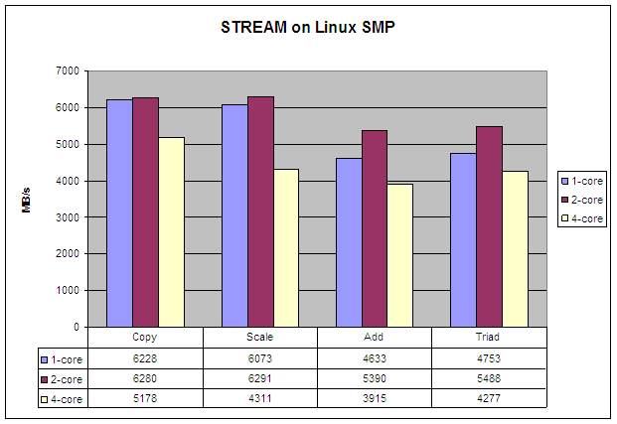
Memory Bandwidth Benchmarks
The STREAM benchmark is the de facto industry standard benchmark for the measurements of computer memory bandwidth.
DDR3-1600 theoretical throughput is 12.8 GB/s
~30% to ~50% achieved
Physical placement of arrays is critical; Linux virtual memory with 4kB pages is good.
Memory bandwidth, external memory only:
Stream Copy a(i) = b(i), where a and a b are arrays.
Stream Scale a(i) = q * b(i), where a and b are arrays, and q is a constant.
Stream Add computes a(i) = b(i) + c(i), where a, b, and c are arrays.
Stream Triad computes a(i) = b(i) + q * c(i), where a, b, and c are arrays, and q is a constant.
Array sizes are defined to force missing on cache regardless of size
Notes:
Stream is defined to use data arrays sized larger than SoC caches so the benefit of large L2 is ignored. Stream exercises the number of outstanding loads and stores, and the write through (or streaming) mode of the L2 cache.
The formula to calculate external memory bandwidth accounts for read and write in copy and scale, and two reads and write in add and triad. The extra read that a write-allocate cache needs is not included in the formula, and turning of the streaming/write-through will significantly drop the results. But code like this is why the streaming mode is there.
Memory location of arrays is critical, maximum number of open DDR pages (sized 8kB) per DDR rank required. Linux page tables with 4kB pages with normal setup results in linear virtual memory being pseudorandom in physical space is close to optimal for stream.

Slide 44
Interrupt Controller
ARM CorePac in KeyStone II
ARM Cortex A-15 Features
Interface to the SOC and Coherency Issues
Benchmarks
Interrupt Controller
Power Management
Debug and Trace

Slide 45
Purpose of Interrupt Controller
Masking and unmasking of interrupts and events
Prioritize interrupt
Distribution of interrupts to the appropriate processor
Software generation of interrupts
Tracking the status of interrupt
Notes:
Wh

Slide 46
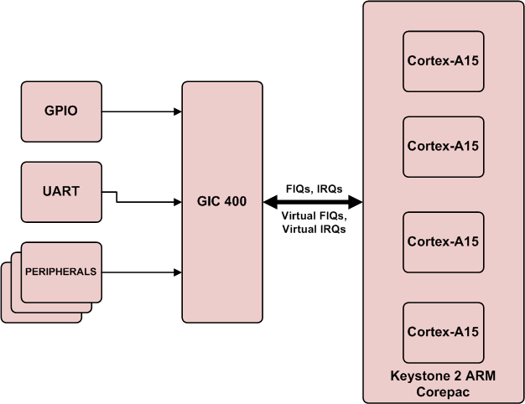
GIC-400 (ARM Generic Interrupt Controller)
Event sources:
Various IP and peripherals
Software generated (SGI ) by ARM core
Signal over the AXI interface
Virtual and physical interrupts
Distribution and CPU interfaces
Notes:
Distribution and CPU interface

Slide 47
GIC-400 Interrupt Controller Distributer Side
The ARM Generic Interrupt Controller, the GIC-400, is a high-performance, area-optimized interrupt controller with an Advanced Microcontroller Bus Architecture (AMBA) Advanced eXtensible Interface (AXI) interface.
Interrupt’s sources
Up to 1020 interrupts
4 special purpose interrupts
Each interrupt has a unique ID
Private and shared interrupts
32 ID for private interrupts, 16 for PPI and 16 for software generated interrupts
Note – These are banked ID, meaning, same ID for different interrupts (for different CPU)

Slide 48
GIC-400 Interrupt Controller CPU Interface
Signal to the CPU is FIQ or IRQ
Grouping
Group 0 interrupts can be sent to processors using IRQ or FIQ
Group 1 interrupts can be sent only via IRQ
Interrupt state – pending, active, active pending
CPU acknowledge the interrupt
Status of interrupt is changing from pending to active or active pending, enable other interrupts

Slide 49
GIC400 in KeyStone II
The following figure gives an overview of the GIC-400 in KeyStone II devices. It shows the interrupts that are sent to the GIC-400 from various sources and the key phases of interrupt-related signaling in the SoC.

Slide 50
Power Management
ARM CorePac in KeyStone II
ARM Cortex A-15 Features
Interface to the SOC and Coherency Issues
Benchmarks
Interrupt Controller
Power Management
Debug and Trace

Slide 51
Advanced Power Management
Multiple power domains inside the ARM CorePac
Extremely fast state save and restore speeds up hibernation
Fine-grain pipeline shutdown using 32-entry loop buffer disables fetch and some decode pipeline stages.

Slide 52
Energy Efficiency
Clock gating inside the ARM CorePac:
Total dynamic power consumption for a fully-loaded 1.4GHz core will range from 1.2W to 0.35W depending on the type of instructions it runs.
Wait for interrupt and event (WFI, WFE) instructions bring the dynamic power down to <0.1W per core.
Power switches per core and per CorePac including L2:
Each ARM A15 core can be shut down independently.
The entire ARM A15 CorePac, including the 4MB/1MB L2 cache, can also be shut down.
Reduces static power to <5%
Notes:
Depending on the transistor temperature, static power (leakage) is ½ to 2/3 of total power. Dynamic power scales with clock speed, static does not.

Slide 53
Debug and Trace
ARM CorePac in KeyStone II
ARM Cortex A-15 Features
Interface to the SOC and Coherency Issues
Benchmark
Interrupt Controller
Power Management
Debug and Trace

Slide 54
Debug and Trace Options
Lab-based debug; CCSv5 gives full support
Run-Time debug module
PMU - performance Monitoring Unit
Set of counters that can count various events
Trace Macrocell
Logic to control the trace
Path to move the trace data outside
Cross trigger unit
Enable event from one CPU to trigger trace at another CPU

Slide 55
Lab-Based Debug
CCSv5 works with the ARM cores.
The ARM integrated development environment, RealView Development Suite (RDS), provides lab-based debug facilities (breakpoint, memory view, etc.).
GNU Debugger (GDB)
ARM hardware Debug registers facilitate debugging

Slide 56
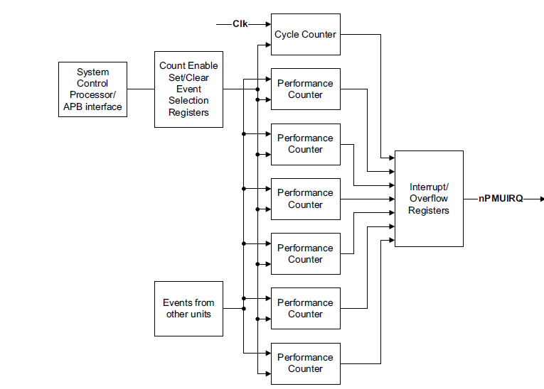
PMU Block Diagram

Slide 57
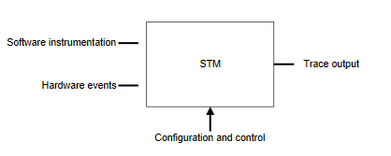
Trace Macrocell
System Trace Macrocell (STM) enables tracing of system activities from multiple sources; either hardware events or software instrumentation.
Coresight is a set of hardware and software architecture specification documents that enables easy development of on-chip trace and debug.

Slide 58
STM Challenges
Facilities for collecting trace data:
Triggering
Filtering
Options for storing and delivering trace data to host:
Export using trace port and trace port analyzer (TPA) to capture the trace information
Write the trace to the Embedded Trace Buffer (ETB) and read it using JTAG or post-mortem memory read

Slide 59
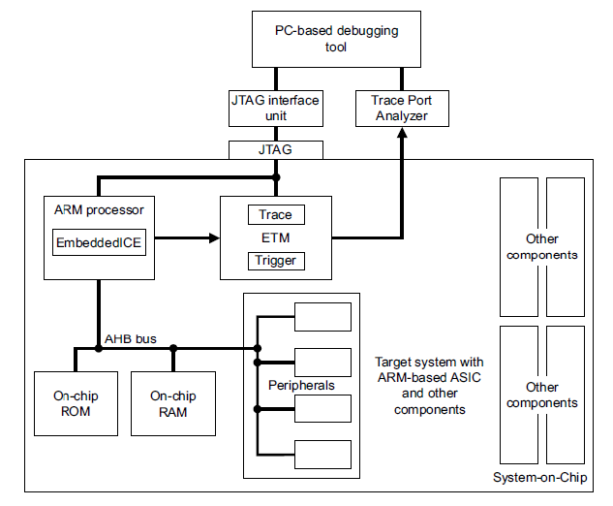
STM as Part of the SoC

Slide 60
Tracing Features
Packetized trace, real-time asynchronous trace export
Multicore trace using single capture unit
Coresight components include:
PTM (Program Flow Trace)
ADI (Arm Debug Interface)
HTM (AHB Trace Macrocell) bus trace
ITM (Instrumentation Trace Macrocell) (printf)
DWT (Data Watch Trace)
Trace Funnel combines multiple trace streams

Slide 61
Embedded Cross Trigger (ECT) Module
CTI controls the trigger interface for each CPU
Combines and maps triggering requests
Enables the debug logic, PTM and PMU to interact with each other and with other CoreSight component
CTM controls the distribution of events across CPUs and from external modules
Matrix connections. Number of trigger inputs and trigger outputs are connected between debug components in the MPCore and CTIs.
Notes:
ECT - Embedded Cross Triggering

Slide 62
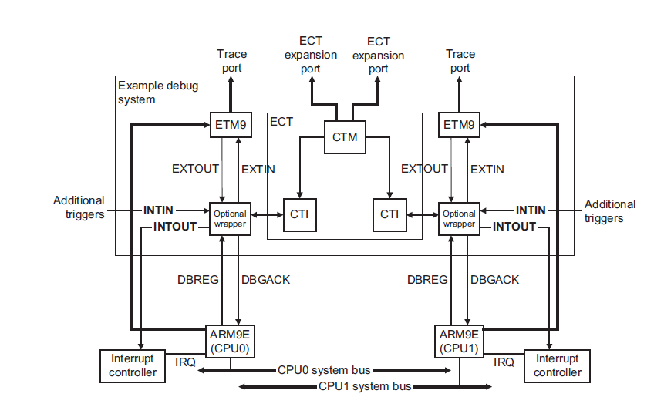
Cross Triggering – 2 CTIs & the CTM

Slide 63
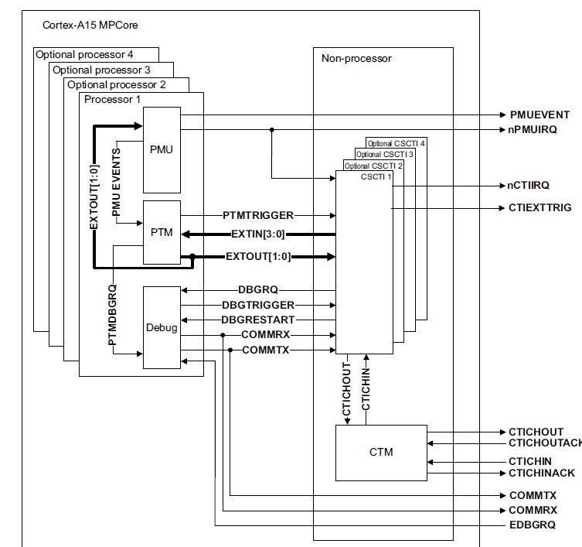
CTI and CTM signals

Slide 64
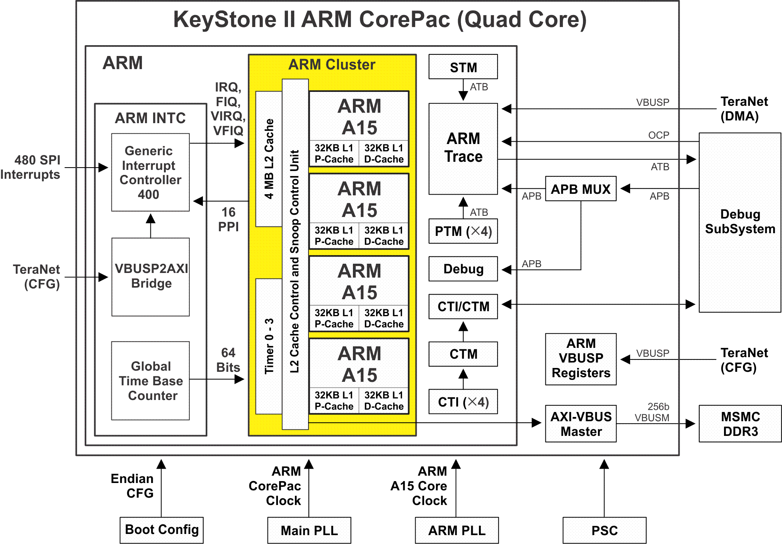
Summary - Quad Cortex-A15
ARM Cortex-A15 MPCore
ARM GIC-400 interrupt controller
Access to and from the SoC
Notes:
Yellow area is the standard quad A15 MPCore with 4MB of shared coherent cache, each core is in its own power switched domain and the MPCore with L2 cache is in a further power switched domain
GIC-400 is the standard interrupt controller from ARM
The path the cores and caches do memory reads and writes goes through Eagles Nest to MSMC. Snooping by MSMC use this path as well
The rest of the interfaces are related to clocking, debugging, tracing, and production testing.

Slide 65
For More Information
ARM Reference Manuals http://infocenter.arm.com/help/index.jsp
A15 Technical Reference Manual (TRM) r2p2
GIC-400 r0p0rel1
STREAM Benchmark http://www.cs.virginia.edu/stream/
For questions regarding topics covered in this training, visit the support forums at the TI E2E Community website.

